Slide 1


Open Technology Workshops
Data Sovereignty

Slide 2
Open Technology Workshops
CONCEPTS
Data Sovereignty

Slide 3
Open Technology Workshops
Our Journey
Vendor Risk
10 types of Vendor Risk
Question 1
Data Sovereignty? (macro)
What is Data Sovereignty? Definitions and approaches
Data Sovereignty (micro)
Group Activity 1
How can this apply to me?
What can my org do?
Notes:
Open source means that the source code is available to the public and has usually has a permissive license for use. This contrasts with closed source software that has a restrictive license and the source code is not available.
Sources:
https://www.turing.com/blog/open-source-vs-commercial-software-license/#:~:text=Users
%20of%20open%20source%20software,to%20users%20without%20upfront%20costs.
https://www.geeksforgeeks.org/difference-between-open-source-software-and-commercial-software/#

Slide 4
Open Technology Workshops
Types of Vendor Risk (1-4)
Strategic risk
When the vendor’s decisions don’t align with your strategy.
Example: Vendor doesn’t want to invest in the tooling needed to improve your service delivery, perhaps pivoting to AI.
Operational risk
When the vendor’s product of service is required to maintain your daily operations.
Example: A vendor having unplanned downtime can unpredictably affect your business.
Business continuity risk
When vendor outages or closure risks business continuity for your organization.
Example: A datacenter located in a place increasingly prone to wildfires may have outdated disaster recovery plans that don’t address current risks.
Compliance and regulatory risk
When the vendor fails to comply with laws and regulations regarding their products and services
Example: A vendor that disregards HIPAA standards could expose your own customers’ data.
Source: https://www.venminder.com/blog/types-vendor-risks-monitor
Notes:
Open source means that the source code is available to the public and has usually has a permissive license for use. This contrasts with closed source software that has a restrictive license and the source code is not available.
Sources:
https://www.turing.com/blog/open-source-vs-commercial-software-license/#:~:text=Users
%20of%20open%20source%20software,to%20users%20without%20upfront%20costs.
https://www.geeksforgeeks.org/difference-between-open-source-software-and-commercial-software/#

Slide 5
Open Technology Workshops
Types of Vendor Risk (5-7)
Information security risk
When the vendor lacks effective information security controls.
Example: A vendor’s improper configuration of a storage bucket could expose your org’s data.
Financial and credit risk
When the vendor’s own ability to meet contractual obligations to their customers.
Example: A vendor with financial trouble could cut costs to other functions which can snowball into other risks like cybersecurity or business continuity.
Reputation risk
When vendor could directly or indirectly damage your organization’s reputation or brand.
Example: A vendor found to have committed fraud could affect your organizations reputation depending on the nature of business relationship, real or perceived.
Source: https://www.venminder.com/blog/types-vendor-risks-monitor
Notes:
Open source means that the source code is available to the public and has usually has a permissive license for use. This contrasts with closed source software that has a restrictive license and the source code is not available.
Sources:
https://www.turing.com/blog/open-source-vs-commercial-software-license/#:~:text=Users
%20of%20open%20source%20software,to%20users%20without%20upfront%20costs.
https://www.geeksforgeeks.org/difference-between-open-source-software-and-commercial-software/#

Slide 6
Open Technology Workshops
Types of Vendor Risk (8-10)
Concentration risk
When one vendor provides a majority of critical services to an org or there a vendor has monopoly power in a market.
Example: Unilateral changes to prices or terms-of-service can cause both financial and strategic risks to organizations.
Geopolitical risk
When the vendor is located in a place vulnerable to political unrest or corruption.
Example: Political unrest makes it difficult for organizations to assess risk and plan for business continuity.
ESG (environmental, social, and governance) risk
When a vendor violates environmental protections or human rights
Example: A vendor conducting business with child labor could put hit your organization with compliance risk.
Source: https://www.venminder.com/blog/types-vendor-risks-monitor
Notes:
Open source means that the source code is available to the public and has usually has a permissive license for use. This contrasts with closed source software that has a restrictive license and the source code is not available.
Sources:
https://www.turing.com/blog/open-source-vs-commercial-software-license/#:~:text=Users
%20of%20open%20source%20software,to%20users%20without%20upfront%20costs.
https://www.geeksforgeeks.org/difference-between-open-source-software-and-commercial-software/#

Slide 7
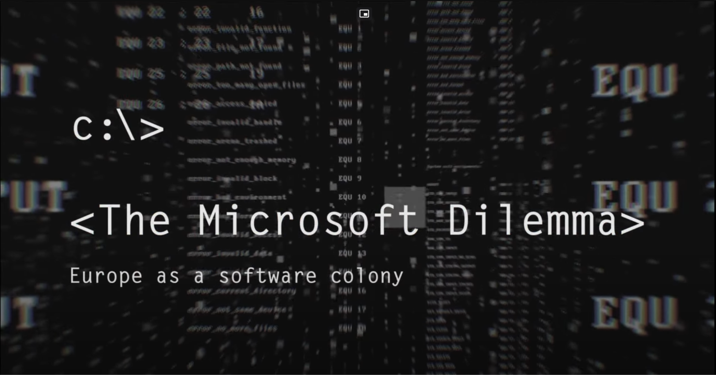
Open Technology Workshops
Question 1
What type of risk(s) does vendor “lock-in” increase?
Answer for (a) single service and (b) a product ecosystem.
Strategic risk
Operational risk
Business continuity risk
Compliance and regulatory risk
Information security risk
Financial and credit risk
Reputation risk
Concentration risk
Geopolitical risk
ESG (environmental, social, and governance) risk
(clip) Microsoft Software - Danger to Europe's independence? - https://www.youtube.com/watch?v=XWn4TXKgidw
Notes:
Open source means that the source code is available to the public and has usually has a permissive license for use. This contrasts with closed source software that has a restrictive license and the source code is not available.
Sources:
https://www.turing.com/blog/open-source-vs-commercial-software-license/#:~:text=Users
%20of%20open%20source%20software,to%20users%20without%20upfront%20costs.
https://www.geeksforgeeks.org/difference-between-open-source-software-and-commercial-software/#

Slide 8
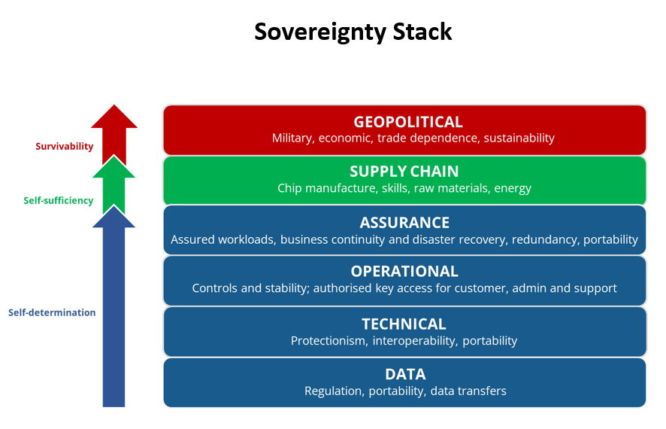
Open Technology Workshops
What is Data Sovereignty?
“Data sovereignty” has many definitions. It can refer to:
Assurance that data stored and processed by cloud providers is subject to the required laws and regulations in the jurisdiction in which the organization resides.
The ability to preserve the data rights of a nation’s citizens.
* The ability to address the vendor risks shown before.
* A path towards self-sufficiency of digital technology.
Image source: https://blog-idceurope.com/the-evolution-of-digital-sovereignty-moving-beyond-data-and-cloud/
Notes:
Open source means that the source code is available to the public and has usually has a permissive license for use. This contrasts with closed source software that has a restrictive license and the source code is not available.
Sources:
https://www.turing.com/blog/open-source-vs-commercial-software-license/#:~:text=Users
%20of%20open%20source%20software,to%20users%20without%20upfront%20costs.
https://www.geeksforgeeks.org/difference-between-open-source-software-and-commercial-software/#

Slide 9
Open Technology Workshops
Group Activity!
From the Data Sovereignty Worksheet”, let’s do this...
If you work in IT or own a business, group up and work on the Business Tech section.
Otherwise, group up and work on the Consumer Tech section.
Notes:
Open source means that the source code is available to the public and has usually has a permissive license for use. This contrasts with closed source software that has a restrictive license and the source code is not available.
Sources:
https://www.turing.com/blog/open-source-vs-commercial-software-license/#:~:text=Users
%20of%20open%20source%20software,to%20users%20without%20upfront%20costs.
https://www.geeksforgeeks.org/difference-between-open-source-software-and-commercial-software/#

Slide 10
Open Technology Workshops
How can this apply to me?
A lack of data sovereignty disallows you to control your own digital destiny.
You can’t “own” anything anymore. Access to movies and songs you “buy” can be arbitrarily revoked.
  Own physical media or backup your media to hard disk.
Tech monopolies only license you to use their software, and they can even prevent hardware functionality if you don’t own a “license” (ie. Apple and Tesla)
  Use tech that’s free and open.
Lax data privacy laws in the US encourage surveillance capitalism and civil rights violations.
  Use services that apply the GDPR or CCPA to your data.
Vendor lock-in is an anti-competitive strategy used to keep you from moving towards any alternatives. Making switching inconvenient (technically or socially) is an unstated goal.
  Use open standards that work across multiple platforms.
  Choose service that allow you to export your data.
Notes:
Open source means that the source code is available to the public and has usually has a permissive license for use. This contrasts with closed source software that has a restrictive license and the source code is not available.
Sources:
https://www.turing.com/blog/open-source-vs-commercial-software-license/#:~:text=Users
%20of%20open%20source%20software,to%20users%20without%20upfront%20costs.
https://www.geeksforgeeks.org/difference-between-open-source-software-and-commercial-software/#

Slide 11
Open Technology Workshops
What can my org do?
Follow the EU
European governments are leading the way in developing and implementing sovereign technology stacks to avoid being dominated by US firms.
The tools and tech used in these drives is compliant with GDPR.
Use federated services like Matrix
Federated services are built to be “owned” and give you full control over your instance of the platform. These services allow your data to be 100% portable.
Using applications that are part of the “Fediverse” reduces market and media concentration for the dominant corporate players.
Explore alternatives
One way to see what a sovereign stack looks like is to explore Federated.computer.
https://www.federated.computer
Stay tuned to LibreTechnica’s new website!
The new website will document full guides to running a sovereign IT stack for your organization.
The Microsoft-Dilemma - Europe as a Software Colony (Full Documentary, 2018)
- https://www.youtube.com/watch?v=duaYLW7LQvg
Notes:
Open source means that the source code is available to the public and has usually has a permissive license for use. This contrasts with closed source software that has a restrictive license and the source code is not available.
Sources:
https://www.turing.com/blog/open-source-vs-commercial-software-license/#:~:text=Users
%20of%20open%20source%20software,to%20users%20without%20upfront%20costs.
https://www.geeksforgeeks.org/difference-between-open-source-software-and-commercial-software/#

Slide 12
Open Technology Workshops
Fin
This presentation contains 0% AI-generated content.
Thank you for coming!

